Slide 1

STANFORD RNA 3D FOLDING
Team Shuttle Presents

Slide 2
CONTENTS
What is RNA Folding?
Competition Objective
Dataset Overview
Feature Engineering
Notebook-1: Baseline Models
Notebook-2: Deep Learning Model
Kaggle Submission
Challenges & Fixes
Future Enhancements
Key Learnings + Q&A

Slide 3
Why RNA Folding Matters
• RNA structure determines biological function
• Lab methods (e.g., crystallography) = very slow & expensive
• AI can accelerate discoveries in medicine & virology
• This competition allows us to help predict spatial 3D shape.

Slide 4
Competition Goal
Predict 3D coordinates of RNA residues Using only sequence information provided Submission → A .csv with xyz positions for each residue in order Metric → Mean Squared Error (MSE) on private test set
Add a statement.
This could be a quote from a project lead
or client feedback.

Slide 5
Dataset Breakdown
HIGHLIGHT 3
Describe another important highlight from last quarter.
HIGHLIGHT 1
Dataset | Size | Labels Available?
Train sequences | 844 | YES
Train labels | 137095 | YES
Validation sequences | 12 | NO
Test residues | 2515 | NO
Present an important highlight from last quarter. Did you meet your targets? Were there any major achievements? Keep it short – you can expand in the following slides.

Slide 6
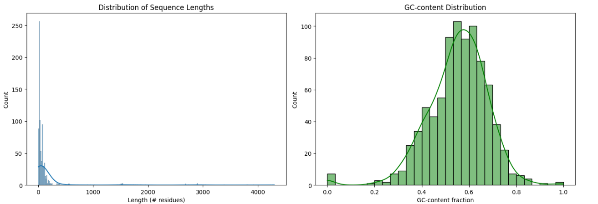
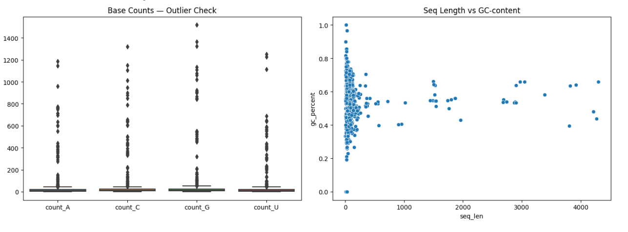

Slide 7
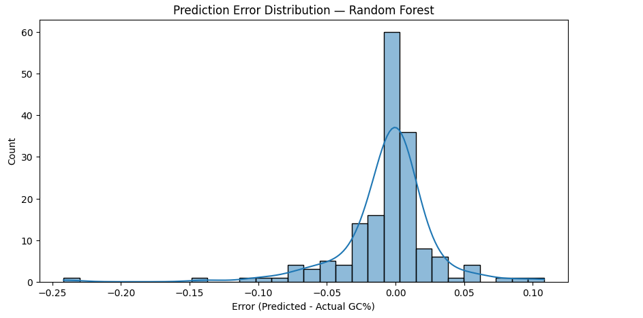
Feature Engineering
We engineered biological features like GC% and sequence length
We engineered useful numeric features from sequence: • GC-percentage per sequence • Sequence length per sequence • Encoded residues based on ID groups
These features help machine learning models understand biochemical trends.
“

Slide 8
MODEL
FEATURES USED
VALIDATION RMSE
Notebook-1: Baseline Models
Linear Regression
Ridge Regression
Random Forest
GC% ONLY
GC% ONLY
GC% ONLY
0.1226
0.1227
0.3599
Conclusion
Conclusion
Conclusion
Weak Pattern
No Improvement
Best Baseline

Slide 9
Deep Learning Architecture
Custom MLP Regression Model
• Input: engineered features (GC%, seq_len)
• Hidden layers: 64 → 128 → 256 (ReLU activations)
• Output: vector of predicted 3D coordinates
• Optimizer: Adam
• Loss: MSE
• Training hardware: GPU T4 ×2
• Improved training stability with proper reshaping
• 8 Epochs training
• Loss decreased steadily
• Model learning spatial distribution, not random noise
Links to resources
Link to resource 1
Link to resource 2

Slide 10
Kaggle Submission
• Generated final predictions for 2,515 test residues
• Submission format initially caused errors
• Fixed column alignment and indexing issues
• Successfully uploaded to Kaggle
• Currently evaluating Public Leaderboard performance.

Slide 11
GOAL 1
GOAL 2
EXTRA
STEPS
GOAL 3
Add transformer or graph neural networks
Predict with sequence windows
Train for longer epochs with better hyperparameters

Slide 12
Key Learnings
1
2
3
4
Hands-on real bioinformatics ML project
Worked with large-scale structured data
Debugged data formats and model training
Completed full ML pipeline:
Data → Feature Eng → Baselines → DL Model → Kaggle Submission

Slide 13
THANK YOU!

